Slide 1
Our Response to COVID-19: Learning for the Future
“this is an opportunity to transform the way we work if we can retain a sense of boldness”

Slide 2
Background and Context
A number of changes have been rapidly made by the Trust in response to the COVID-19 pandemic
We do not have a good understanding of the impact of these changes on staff and people who use our services
We do not know if and how we might sustain some of these changes once the pandemic is over

Slide 3
Objectives
To identify key changes made in response to COVID-19
To evaluate the impact of these changes on staff, service users, digital and leadership
To capture our organisational learning and ascertain the sustainability of these changes post-COVID-19
To conduct the evaluation within a short (4 week) timeframe to facilitate acting upon lessons learnt prior to the arrival of the ‘new normal’

Slide 4
Project Team
Mark Hayward, Director of Research
Clara Strauss, Deputy Director of Research
Jonathan Beder, Director of Transformation
Hilary Charlton, Clinical Programme Lead – Clinical Strategy
Tony Sharp, Head of Strategic Planning
Karen Burch, Business Development Manager
Dr. Saleema Durgahee, Locum Consultant Liaison Psychiatrist
Liz Holland, Associate Director of People Participation
Samantha Doll, Business Manager to CEO
Support with content analysis: Catarina Sacadura & Ellie Ball (R&D Dept)

Slide 5
Methodology
Step 1: Interviews with senior staff to identify key changes, their impact and sustainability
Key changes used to form a ‘long list’ from which survey items could be selected
Step 2: Online surveys for staff and service users
‘Short list’ of key changes used to elicit views and experiences of staff and service users – quantitatively and qualitatively

Slide 6
Step 1 - Methodology
The following headings were used to guide the interviews with senior staff:
What changes have been made to your directorate/discipline/service?
Why was the change made?
What has been the positive impact of this change, if any?
What has been the negative impact of this change, if any?
What are your views about sustaining this change?

Slide 7
Step 1 - Findings
Interviews with 27 senior staff generated a long list of 23 changes. The long list was themed to create the following 7 changes for the short list of changes relevant to staff:
Phone/videoconferencing for appointments with service users
Videoconferencing for team and other meetings
Changes to supporting people in crisis, including A&E diversion
Staff working from home
Rapidity of decision making and action
Greater focus on staff wellbeing
Frequent communication from Exec team/Gold Command to all staff

Slide 8
Step 1 - Findings
The themes from the long list created 5 changes that were relevant to service users:
Phone/videoconferencing for appointments with service users
Staff wearing PPE
Changes to supporting people in crisis, including A&E diversion
Greater involvement of friends and families
Greater levels of communication from the Trust

Slide 9
Step 2 - Methodology
The short list of changes was used to create one online survey for staff (7 changes) and one online survey for services users (5 changes). Respondents were invited to rate statements about each change (on a 5-point scale from ‘strongly disagree’ to ‘strongly agree’), in relation to the:
Positive impact of each change
Negative impact of each change
Sustainability of each change post-COVID
…. and to offer their own comments on each change and its impact
The staff survey was designed and distributed in collaboration with the Communications team. The service user survey was distributed to their networks by the People Participation team.

Slide 10
Step 2 – Findings (staff)
The survey was sent by email to 5842 staff
1096
Responses
(28 April – 13 May 2020)
658
‘clinical’ staff
376
‘non-clinical’ staff
62 staff did not indicate their clinical/non-clinical role

Slide 11
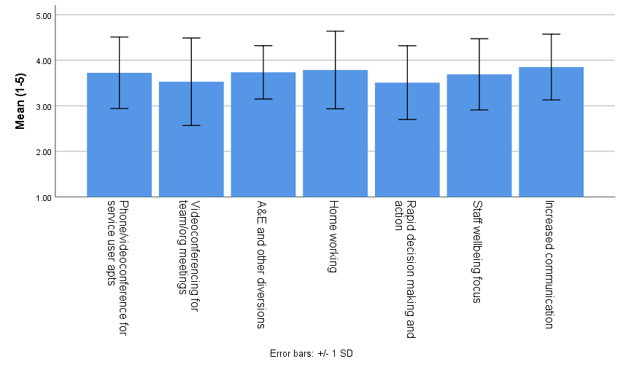
Step 2 – Findings (staff): Positive Impacts
1=Strongly disagree
2=Somewhat disagree
3=Neither
4=Somewhat agree
5=Strongly agree
Interpretation – on average, respondents agreed that positive impacts had resulted from each change
Approx. 68% of respondents score within the black bars

Slide 12
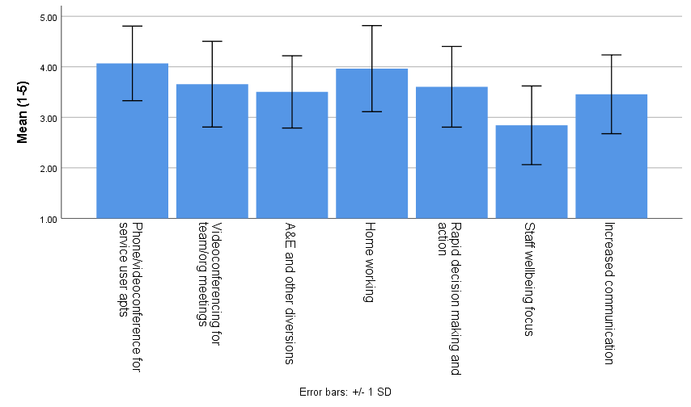
Step 2 – Findings (staff) : Negative Impacts
1=Strongly disagree
2=Somewhat disagree
3=Neither
4=Somewhat agree
5=Strongly agree
Interpretation – on average, respondents agreed that negative impacts had resulted from each change
Approx. 68% of respondents score within the black bars

Slide 13
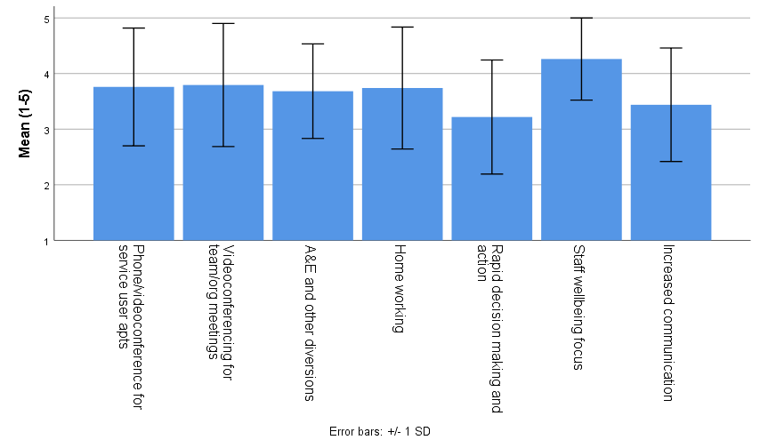
Step 2 – Findings (staff): Sustainability
1=Strongly disagree
2=Somewhat disagree
3=Neither
4=Somewhat agree
5=Strongly agree
Interpretation – on average, respondents agreed that each change was sustainable
Approx. 68% of respondents score within the black bars

Slide 14
Step 2 – Findings (staff): Respondents’ Own Comments
Comments on the positive and negative impacts of each change were subjected to content analysis*
Most commonly mentioned themes are reported, with up to two positive and two negative themes reported per change
Example verbatim comments are given to illustrate each theme
* Comments were analysed from the initial cohort of 681 staff who completed the survey

Slide 15
Change 1: Phone/videoconferencing for appointments with service users
Most mentioned positive/negative themes (no. of mentions) | Example comments from survey
Less travel (108) | “Allows you to be more productive" "Better for the environment"
Treatment easily accessible (122) | “Easier for patients who struggle to attend appointment for a host of reasons including finances, mental health and anxiety" "Patients appear to be more grateful for the sessions so seem to value the input being delivered in this way"
Not suitable for certain types of appointment/intervention (212) | "Not possible to complete a full specialist assessment of physical health using video alone" "Very difficult conducting telephone assessment with clients who have cognitive impairments"
Reliant on system/network capacity (109) | "Poor connection causing delay in auditory feedback and freezing" "A lot of older adults do not use computers, therefore do not have access to videoconferencing."

Slide 16
Change 2: Videoconferencing for team and other meetings
Most mentioned positive/negative themes (no. of mentions) | Example comments from survey
Less travel (198) | "I strongly prefer video meetings to face to face because commuting is costly and time consuming. It feels good to have lower carbon emissions from not commuting.”
Easier and quicker to get everyone together (105) | "Staff daily Skype - has helped for all staff to feel supported” "Staff who do not normally attend the meeting have been able to join"
Face to face contact is missed (128) | "Isolated at home with no team contact” “Loss of sense of personal connection”
Reliant on system/network capacity (102) | “IT not always working” “Always some delay due to people not being able to log on/access VPN, get speakers or microphones working.”

Slide 17
Change 3: Changes to supporting people in crisis, including A&E diversion
Most mentioned positive/negative themes (no. of mentions) | Example comments from survey
More suitable than A&E (100) | "A&E difficult experience for SUs this is more dignified" "People seen only by MH staff, not general trained colleagues who may be less sympathetic"
Closer working between teams/trusts (32) | "Clearer communication between departments" "Ability to share more cohesively what is working well and not across all the teams"
Strengthens divide between mental and physical health (25) | "Individuals may need physical health interventions in addition to mental health, such as with severe self-harm or suicide attempts"
Hubs not working efficiently yet (28) | “Lack of proper facilities (showers, meals etc)“ "Environments may not currently meet needs or be as adaptable"

Slide 18
Change 4: Staff working from home
Most mentioned positive/negative themes (no. of mentions) | Example comments from survey
No commuting (195) | “More productivity - less time travelling” “No parking issues once you get to work” “Reduces staff stress getting into work”
More productive, more focused and fewer distractions (104) | “I can concentrate without having to listen to loud colleagues” “Fewer distractions than in office environment”
Not suitable for everyone (307) | “Isolating to work on your own all the time, particularly if your role is normally quite isolated” “Not feeling part of the team”
Impeding quality of work/service (69) | “Prioritising admin over direct client contact, as easier to do admin from home” "Missing out on case discussions with colleagues for quick discussion, less likely to call others"

Slide 19
Change 5: Rapidity of decision making and action
Most mentioned positive/negative themes (no. of mentions) | Example comments from survey
Giving all staff more of a voice/trust (22) | “People feel empowered to act” "Managers have seen staff are able to make more decisions for themselves."
More effective and efficient (41) | "A chance to utilise initiative and creative decision making." "Expands the ability to work creatively and think outside the box when working with clients "
Potential for burn out with rate of change (37) | "The changes e.g. virtual were brought in so quickly and were very stressful/ triggered anxiety for me" "Potential for staff members to holding greater levels of risk - leads to burn-out. "
Changes might not be as successful as they could have been if made more slowly (36) | “The decisions made in regard to Primary Care services have been very short-sighted” “Hastily made decisions can often have unintended consequences"

Slide 20
Change 6: Focus on staff wellbeing
Most mentioned positive/negative themes (no. of mentions) | Example comments from survey
Increased focus on staff wellbeing and resources to support this (59) | "People can feel more confident about ensuring they have a health work/life balance" “Yoga/mindfulness classes incorporated into working day" "A lot of resources for staff are available"
Sense of being valued (35) | "Caring management and they put the needs of staff first" "Feels more like a big family looking out for each other"
Staff wellbeing not taken seriously enough (31) | "I have not seen an increased focus on staff support - I have experienced the opposite.” "I was not aware of a greater focus on wellbeing!"
Staff shortages/redeployment means greater pressures on staff (12) | "Service provision greatly reduced due to redeployment of staff" “Locates the issue with stress as 'our' fault and not because too much is requested"

Slide 21
Change 7: Frequent comms from Exec team/Gold Command to all staff
Most mentioned positive/negative themes (no. of mentions) | Example comments from survey
Staff are more informed of what is happening in the organisation (38) | “Clearest communication there ever has been” “I have found the information, daily email, and regular webinars have been very reassuring and helpful during this difficult time.”
Execs supportive and visible, making the organisation feel more cohesive (45) | "Exec team have appeared accessible" "I feel much more connected to Executive Team as it it feels that we all have a shared focus."
Overload of communication at times (107) | “Weekly bulletin or urgent messages only please” “There do seem to be too many communications at present.” “Messages have sometimes been repetitive”
Poor quality of communication (15) | “Doesn't feel sincere when routinely sent" "Information is too general. There is a huge amount of communication coming through, but little content. "

Slide 22
Step 2 – Findings (service users)
The survey was completed by 13 respondents – generating insufficient data for a quantitative analysis
A review of all the data (quantitative and qualitative) by the People Participation team suggested that:
Communication with people using services could definitely be better
There are positive and negative aspects of video appointments
Staff in PPE is more negative than positive
Alternatives to A&E are more positive than negative
After the pandemic, people want ongoing better communication, more ways to involve families and different ways to access support in a crisis

Slide 23
Key Learning
The delivery of this project within a short timeframe has provided a further example of the rapidity of decision-making and action that has been possible during the pandemic
Staff were well engaged with the process of evaluating COVID-19 changes and their sustainability
All shortlisted changes were evaluated by staff as having a moderately positive impact and as potentially sustainable post-pandemic
All shortlisted changes were evaluated by staff as having a moderately negative impact, with their own comments indicating potential solutions to some of the negative impacts

Slide 24
Key Learning
‘Greater focus upon staff wellbeing’ was rated by staff as having the least negative impact and generated the highest rating for sustainability
Positive comments and sustainability ratings concerning homeworking and videoconferencing for team meetings suggests these areas have the potential to continue post-COVID-19 – further exploration is now needed
The mixed (positive and negative) comments on videoconference/phone appointments for service users warrants further exploration
There is potential for all shortlisted staff changes to be linked to and inform the delivery of the Trust’s 2020-21 Breakthrough Objectives of: 1. Delivering a 24/7 Crisis service 2. New Model for Adult Community Services 3. Develop a Learning System 4. Digital Adoption Programme

Slide 25
Learning from the process
The value of working across usual boundaries and tribes
The momentum generated by a focused project and tight timelines
The value of doors being opened by the project being ‘authorized’ by the CEO
The application of research methodology to aid learning through evidence

Slide 26
Limitations
Within the project timeframe, it was not possible to elicit a large and representative response from service users
The desire not to burden respondents with too many questions meant there was a:
lack of demographic questions in the staff survey – limiting opportunities to assess the impact of changes upon particular disciplines, services, localities, etc
lack of an in-depth exploration about the impact and sustainability of changes

Slide 27
STOPPED STARTED
Collective Sense Making: Ian Burbidge, RSA, 29 April 2020
END Started due to crisis, will stop post-crisis We’ve done these things to respond to immediate demands but they are specific to the crisis | AMPLIFY Started due to crisis, may want to sustain and develop post-crisis We’ve been able to try these new things and they show some signs of promise for the future
LET GO Stopped due to crisis, do not want to restart post-crisis We’ve been able to stop doing these things that were already/are now unfit for purpose | RESTART Stopped due to crisis, want to restart post-crisis We’ve had to stop these things to focus on the crisis but they need to be picked up in some form
NEW PRACTICE
DURING CRISIS
OLD PRACTICE
STOPPED STARTED
POST-CRISIS
Model from Ian Burbidge, RSA, Apr 2020

Slide 28
STOPPED STARTED
Collective Sense Making: COVID-19 Learning for the Future Project May 2020 – Recommendations
END (responses to immediate and specific demands of COVID-19) Phone/videoconferencing as only option for routine service user appointments Videoconferencing as the norm for team/other meetings Home working as the only option for all staff where working from home is possible | AMPLIFY (showing show some signs of future promise) Widespread phone/videoconferencing for service user appointments Videoconferencing for some meetings (esp. to avoid staff travel, where quick meetings are needed) Consolidating specialist mental health crisis response services Home working as an option for some staff some of the time Streamlining decision making, empowering all staff to make decisions and being ambitious about time frames Greater focus on staff wellbeing Frequent communications from the Exec Team
LET GO (stopped these things that are unfit for purpose) Face to face appointments as only option for service users Face to face meetings as the norm Going to A&E for mental health crises Staff coming into work daily, even when working from home is possible and preferred Careful and slow decision making as the norm, impeding action | RESTART (put on hold to focus on COVID-19 but need to restart) Face to face appointments for service users as an option where this is preferred or needed (e.g. physical health checks) Face to face meetings where travel isn’t needed or minimal Staff coming into the office where this is necessary and preferred Taking time to make decisions and action plan where necessary, but not going back to how it used to be
NEW PRACTICE
DURING CRISIS
OLD PRACTICE
STOPPED STARTED
POST-CRISIS
Model taken from Ian Burbidge, RSA, Apr 2020

Slide 29
Thank you for your time and attention!
We would be happy to respond to any questions and curiosities

